Slide 1
Business Process
Hussein Issa

Slide 2
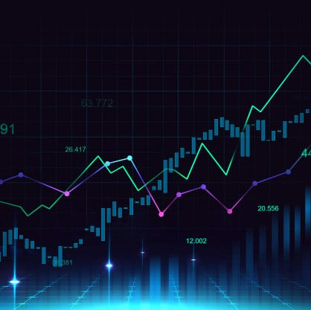
Stock prediction
To recap my project, it’s a stock market prediction and I will use python in google collab.

Slide 3
Timeline
Week 5
Gathering historical data market for famous companies such as apple, amazon etc.
Week 6
Deal with missing values and outliers like mean, deletion etc.
Week 7
Plots to identify outliers and solve it.
Week 8
To improve the prediction accuracy like feature scaling (converge faster).
Week 9
Trying some algorithms to see which model will suit it more.
Linear regression
Random forest
LSTM (ANN)
Data Preprocessing
Data Preprocessing
Feature Engineering
Model
Selection
.CSV Data

Slide 4
Timeline
Week 10
Trying some algorithms to see which model will suit it more.
Linear regression
Week 11
Fitting the train part from the data.
Week 12
Fitting the train part from the data.
Week 13
Predict the x test part.
Week 14
To present the predictions like matplotlib plots.
Random forest
LSTM (ANN)
Accuracy, MAPE , RMSE.
Model
Selection
Model
Training
Model
Training
Evaluation
Data
Visualization

Slide 5
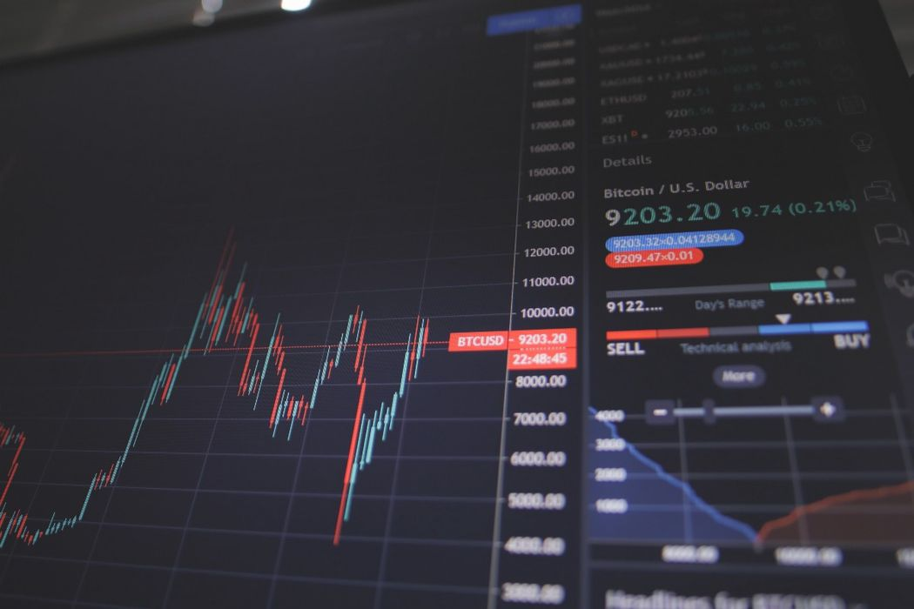
Week 15
The last week I will write the summary of the whole report and present my project.

Slide 6




Thank you
Hussein Issa
hussein.issa.op@gmail.com

